Slide 1
Mathematics for AI
Adams Wai Kin Kong
School of Computer Science and Engineering
Nanyang Technological University, Singapore
adamskong@ntu.edu.sg
Copyright © Cengage Learning. All rights reserved.

Slide 2
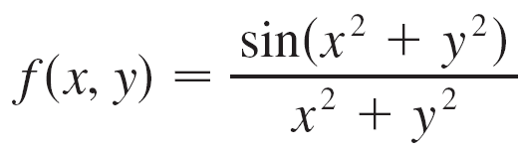
Limits and Continuity
Let’s compare the behavior of the functions
and
as x and y both approach 0 [and therefore the point (x, y) approaches the origin].

Slide 3
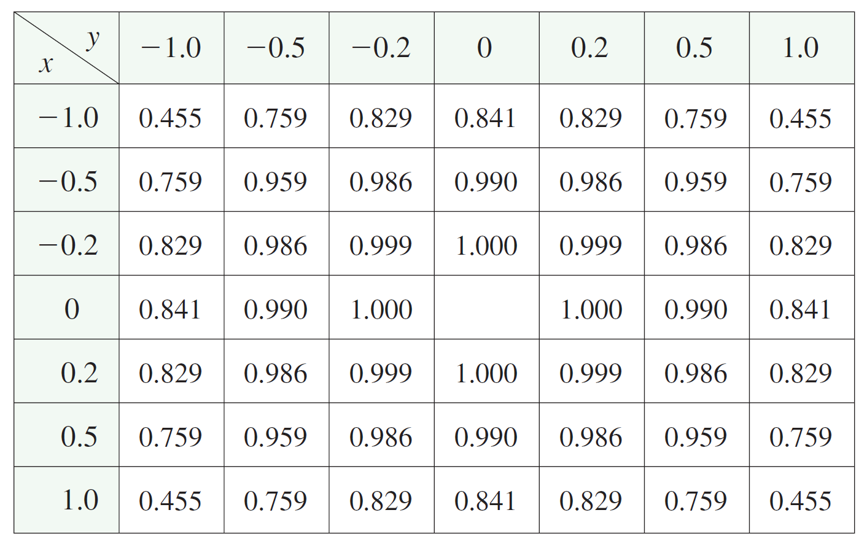
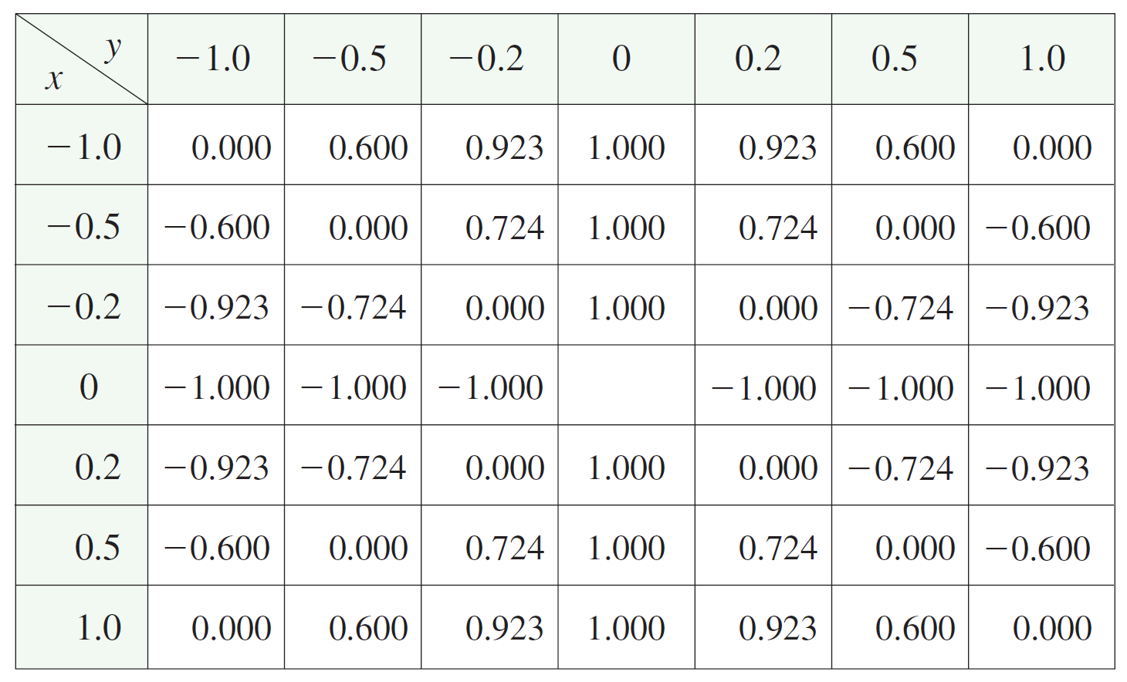
Limits and Continuity
Tables 1 and 2 show values of f (x, y) and g (x, y), correct to three decimal places, for points (x, y) near the origin. (Notice that neither function is defined at the origin.)
Values of f (x, y)
Values of g (x, y)
Table 1
Table 2

Slide 4
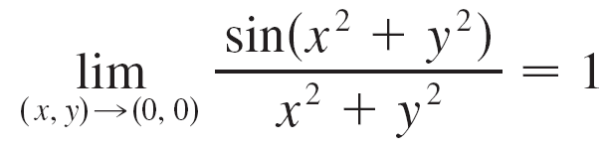
Limits and Continuity
It appears that as (x, y) approaches (0, 0), the values of f (x, y) are approaching 1 whereas the values of g (x, y) aren’t approaching any number. It turns out that these guesses based on numerical evidence are correct, and we write
and
does not exist

Slide 5
Limits and Continuity
In general, we use the notation
to indicate that the values of f (x, y) approach the number L as the point (x, y) approaches the point (a, b) along any path that stays within the domain of f.

Slide 6
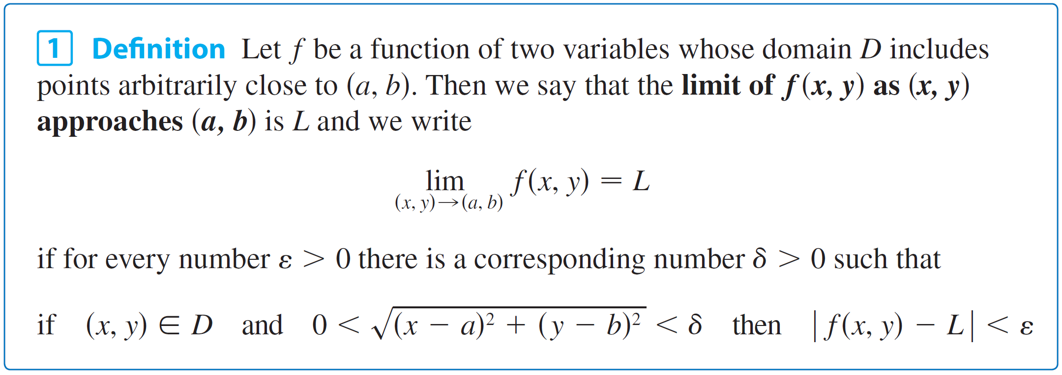
Limits and Continuity
In other words, we can make the values of f (x, y) as close to L as we like by taking the point (x, y) sufficiently close to the point (a, b), but not equal to (a, b). A more precise definition follows.

Slide 7
Limits and Continuity
Other notations for the limit in Definition 1 are
and
f (x, y) → L as (x, y) → (a, b)
For functions of a single variable, when we let x approach a, there are only two possible directions of approach, from the left or from the right.
We know that if lim_{x→a}- f (x) ≠ lim_{x→a}+ f (x), then lim_{x→a} f (x) does not exist.

Slide 8
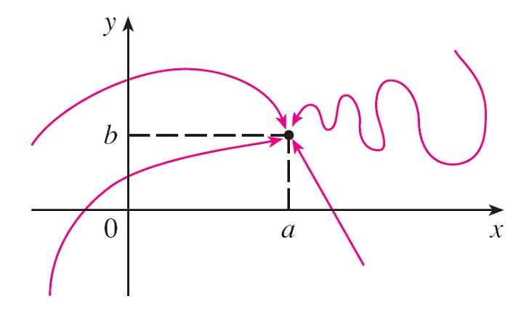
Limits and Continuity
For functions of two variables the situation is not as simple because we can let (x, y) approach (a, b) from an infinite number of directions in any manner whatsoever (see Figure 3) as long as (x, y) stays within the domain of f.
Figure 3

Slide 9
Limits and Continuity
Definition 1 says that the distance between f (x, y) and L can be made arbitrarily small by making the distance from (x, y) to (a, b) sufficiently small (but not 0).
The definition refers only to the distance between (x, y) and (a, b). It does not refer to the direction of approach.
Therefore, if the limit exists, then f (x, y) must approach the same limit no matter how (x, y) approaches (a, b).

Slide 10
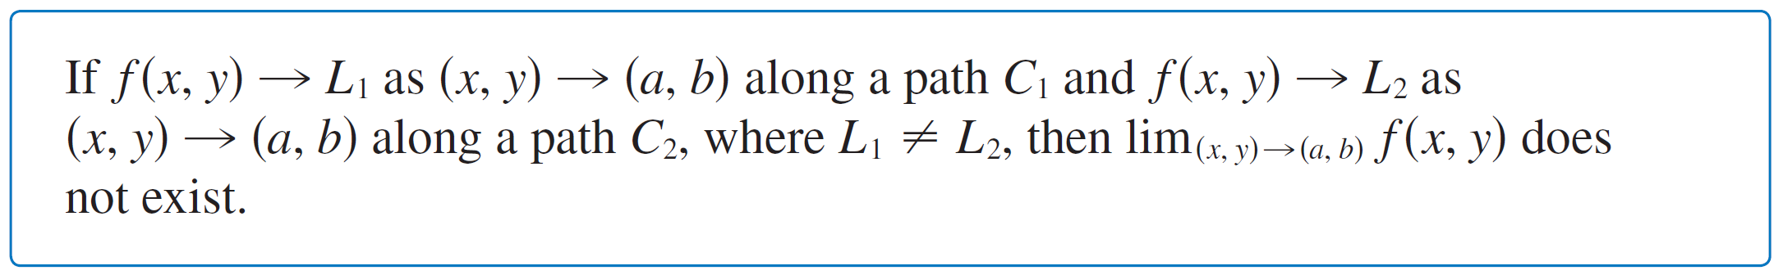
Limits and Continuity
Thus, if we can find two different paths of approach along which the function f (x, y) has different limits, then it follows that lim_{(x, y) → (a, b)} f (x, y) does not exist.

Slide 11
Example 1
Show that does not exist.
Solution:
Let f (x, y) = (x² – y²)/(x² + y²).
First let’s approach (0, 0) along the x-axis.
Then y = 0 gives f (x, 0) = x²/x² = 1 for all x ≠ 0, so
f (x, y) → 1 as (x, y) → (0, 0) along the x-axis

Slide 12
Example 1 – Solution
We now approach along the y-axis by putting x = 0.
Then for all y ≠ 0, so
f (x, y) → –1 as (x, y) → (0, 0) along the y-axis
Thus limit doesn’t exist.
Figure 4

Slide 13

Limits and Continuity
Now let’s look at limits that do exist. Just as for functions of one variable, the calculation of limits for functions of two variables can be greatly simplified by the use of properties of limits.
The Limit Laws can be extended to functions of two variables: the limit of a sum is the sum of the limits, the limit of a product is the product of the limits, and so on.
In particular, the following equations are true.
The Squeeze Theorem also holds.

Slide 14
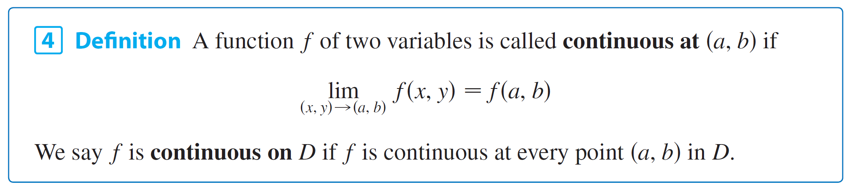
Continuity
We know that evaluating limits of continuous functions of a single variable is easy.
It can be accomplished by direct substitution because the defining property of a continuous function is lim_{x→a} f (x) = f (a).
Continuous functions of two variables are also defined by the direct substitution property.

Slide 15
Continuity
The intuitive meaning of continuity is that if the point (x, y) changes by a small amount, then the value of f (x, y) changes by a small amount.
This means that a surface that is the graph of a continuous function has no hole or break.
Using the properties of limits, you can see that sums, differences, products, and quotients of continuous functions are continuous on their domains.
Let’s use this fact to give examples of continuous functions.

Slide 16
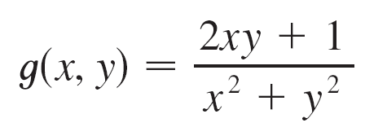
Continuity
A polynomial function of two variables (or polynomial, for short) is a sum of terms of the form cx^{m}y^{n}, where c is a constant and m and n are nonnegative integers.
A rational function is a ratio of polynomials.
For instance,
f (x, y) = x⁴ + 5x³y² + 6xy⁴ – 7y + 6
is a polynomial, whereas
is a rational function.

Slide 17
Continuity
The limits in (2) show that the functions f (x, y) = x, g(x, y) = y, and h(x, y) = c are continuous.
Since any polynomial can be built up out of the simple functions f, g, and h by multiplication and addition, it follows that all polynomials are continuous on .
Likewise, any rational function is continuous on its domain because it is a quotient of continuous functions.

Slide 18

Example 5
Evaluate
Solution:
Since f (x, y) = x²y³ – x³y² + 3x + 2y is a polynomial, it is continuous everywhere, so we can find the limit by direct substitution:
(x²y³ – x³y² + 3x + 2y) = 1²  2³ – 1³  2² + 3  1 + 2  2
= 11

Slide 19
Continuity
Just as for functions of one variable, composition is another way of combining two continuous functions to get a third.
In fact, it can be shown that if f is a continuous function of two variables and g is a continuous function of a single variable that is defined on the range of f, then the composite function h = g ° f defined by h (x, y) = g (f (x, y)) is also a continuous function.
How about deep network, continue or not?

Slide 20
Functions of Three or More Variables
Everything that we have done in this section can be extended to functions of three or more variables.
The notation
means that the values of f (x, y, z) approach the number L as the point (x, y, z) approaches the point (a, b, c) along any path in the domain of f.

Slide 21
Functions of Three or More Variables
Because the distance between two points (x, y, z) and (a, b, c) in is given by , we can write the precise definition as follows: for every number ε > 0 there is a corresponding number δ > 0 such that
if (x, y, z) is in the domain of f and
0 < < δ
then | f (x, y, z) – L | < ε

Slide 22
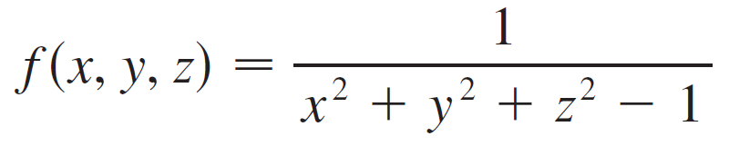
Functions of Three or More Variables
The function f is continuous at (a, b, c) if
For instance, the function
is a rational function of three variables and so is continuous at every point in except where x² + y² + z² = 1. In other words, it is discontinuous on the sphere with center the origin and radius 1.

Slide 23
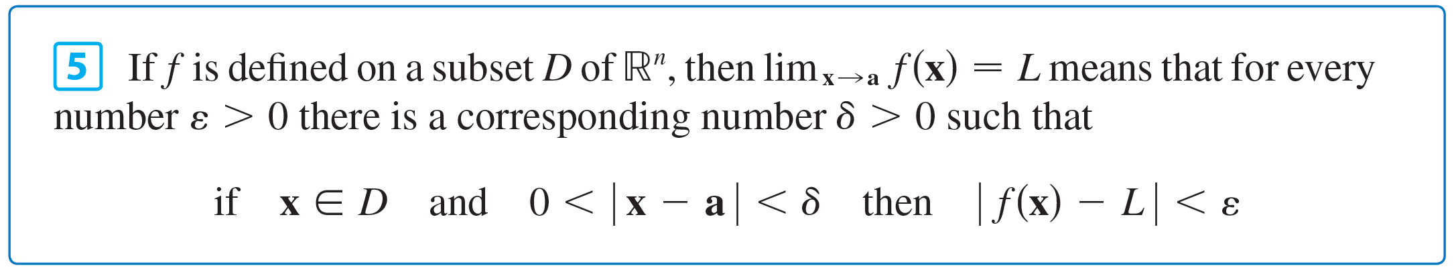
Functions of Three or More Variables
We can write the definitions of a limit for functions of two or three variables in a single compact form as follows.

Slide 24
Partial Derivatives

Slide 25
Partial Derivatives
On a hot day, extreme humidity makes us think the temperature is higher than it really is, whereas in very dry air we perceive the temperature to be lower than the thermometer indicates.
The National Weather Service has devised the heat index (also called the temperature-humidity index, or humidex, in some countries) to describe the combined effects of temperature and humidity.
The heat index I is the perceived air temperature when the actual temperature is T and the relative humidity is H. So I is a function of T and H and we can write I = f (T, H).

Slide 26
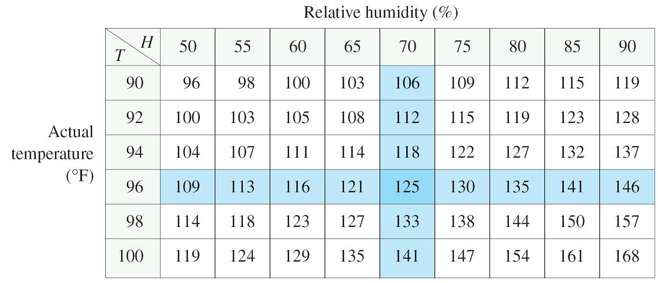
Partial Derivatives
The following table of values of I is an excerpt from a table compiled by the National Weather Service.
Heat index I as a function of
temperature and humidity
Table 1

Slide 27
Partial Derivatives
If we concentrate on the highlighted column of the table, which corresponds to a relative humidity of H = 70%, we are considering the heat index as a function of the single variable T for a fixed value of H. Let’s write g(T ) = f (T, 70).
Then g (T ) describes how the heat index I increases as the actual temperature T increases when the relative humidity is 70%.
The derivative of g when T = 96°F is the rate of change of I with respect to T when T = 96°F:

Slide 28
Partial Derivatives
We can approximate g ′(96) using the values in Table 1 by taking h = 2 and –2:
Averaging these values, we can say that the derivative g ′(96) is approximately 3.75.

Slide 29
Partial Derivatives
This means that, when the actual temperature is 96°F and the relative humidity is 70%, the apparent temperature (heat index) rises by about 3.75°F for every degree that the actual temperature rises!

Slide 30
Partial Derivatives
Now let’s look at the highlighted row in Table 1, which corresponds to a fixed temperature of T = 96°F.
Heat index I as a function of
temperature and humidity
Table 1

Slide 31
Partial Derivatives
The numbers in this row are values of the function G(H) = f (96, H), which describes how the heat index increases as the relative humidity H increases when the actual temperature is T = 96°F.
The derivative of this function when H = 70% is the rate of change of I with respect to H when H = 70%:

Slide 32
Partial Derivatives
By taking h = 5 and –5, we approximate G′(70) using the tabular values:
By averaging these values we get the estimate G′(70) ≈ 0.9. This says that, when the temperature is 96°F and the relative humidity is 70%, the heat index rises about 0.9°F for every percent that the relative humidity rises.

Slide 33

Partial Derivatives
In general, if f is a function of two variables x and y, suppose we let only x vary while keeping y fixed, say y = b, where b is a constant.
Then we are really considering a function of a single variable x, namely, g(x) = f (x, b). If g has a derivative at a, then we call it the partial derivative of f with respect to x at (a, b) and denote it by f_{x} (a, b). Thus

Slide 34
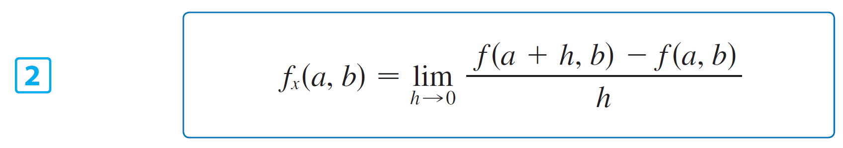
Partial Derivatives
By the definition of a derivative, we have
and so Equation 1 becomes

Slide 35
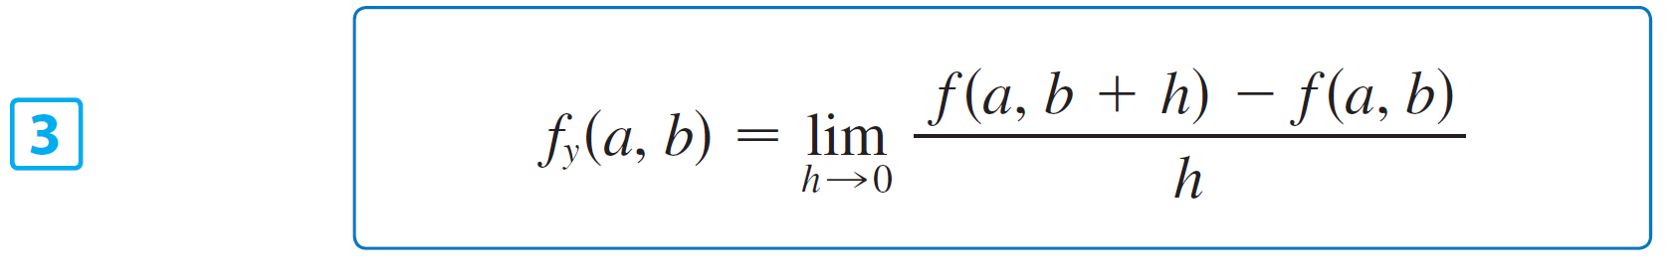
Partial Derivatives
Similarly, the partial derivative of f with respect to y at (a, b), denoted by f_{y}(a, b), is obtained by keeping x fixed (x = a) and finding the ordinary derivative at b of the function G(y) = f (a, y):
With this notation for partial derivatives, we can write the rates of change of the heat index I with respect to the actual temperature T and relative humidity H when T = 96°F and H = 70% as follows:
f_{T} (96, 70) ≈ 3.75 f_{H}(96, 70) ≈ 0.9

Slide 36
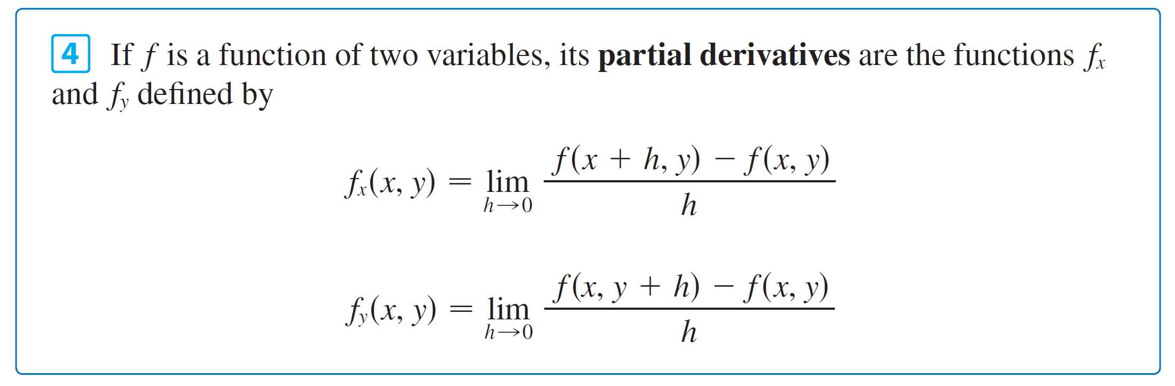
Partial Derivatives
If we now let the point (a, b) vary in Equations 2 and 3, f_{x} and f_{y} become functions of two variables.

Slide 37
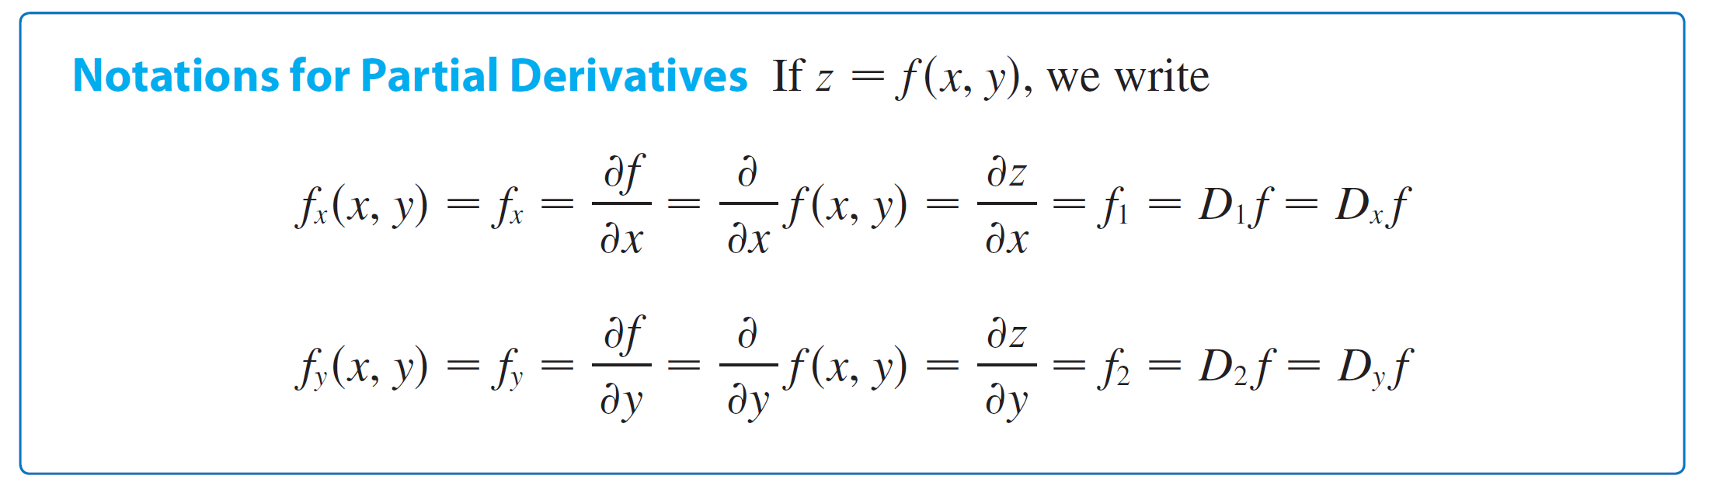
Partial Derivatives
There are many alternative notations for partial derivatives.
For instance, instead of f_{x} we can write f₁ or D₁f (to indicate differentiation with respect to the first variable) or ∂f / ∂x.
But here ∂f / ∂x can’t be interpreted as a ratio of differentials.

Slide 38
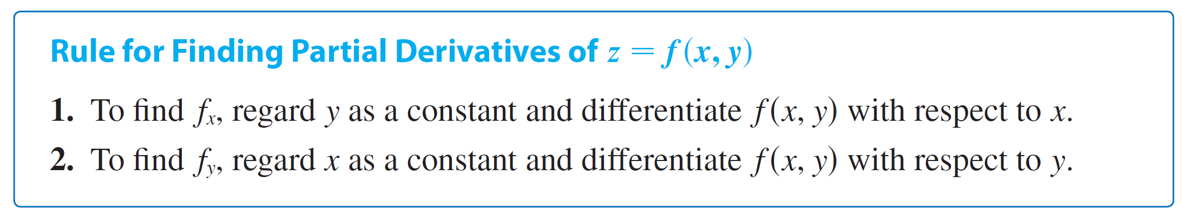
Partial Derivatives
To compute partial derivatives, all we have to do is remember from Equation 1 that the partial derivative with respect to x is just the ordinary derivative of the function g of a single variable that we get by keeping y fixed.
Thus we have the following rule.

Slide 39
Example 1
If f (x, y) = x³ + x²y³ – 2y², find f_{x}(2, 1) and f_{y}(2, 1).
Solution: Holding y constant and differentiating with respect to x, we get
f_{x}(x, y) = 3x² + 2xy³
and so f_{x}(2, 1) = 3  2² + 2  2  1³=16
Holding x constant and differentiating with respect to y, we get
f_{y}(x, y) = 3x²y² – 4y
f_{y}(2, 1) = 3  2²  1² – 4  1=8

Slide 40
Interpretations of Partial Derivatives
To give a geometric interpretation of partial derivatives, we recall that the equation z = f (x, y) represents a surface S (the graph of f ). If f (a, b) = c, then the point P(a, b, c) lies on S.
By fixing y = b, we are restricting our attention to the curve C₁ in which the vertical plane y = b intersects S. (In other words, C₁ is the trace of S in the plane y = b.)

Slide 41
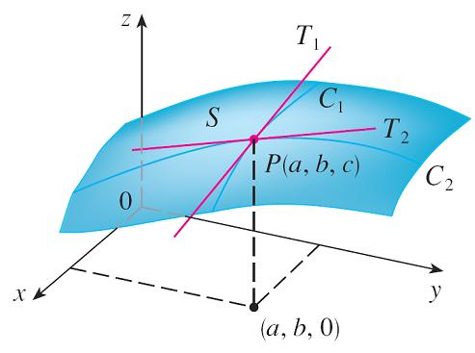
Interpretations of Partial Derivatives
Likewise, the vertical plane x = a intersects S in a curve C₂. Both of the curves C₁ and C₂ pass through the point P. (See Figure 1.)
Note that the curve C₁ is the graph of the function g(x) = f (x, b), so the slope of its tangent T₁ at P is g ′(a) = f_{x} (a, b).
The curve C₂ is the graph of the function G(y) = f (a, y), so the slope of its tangent T₂ at P is G′(b) = f_{y} (a, b).
The partial derivatives of f at (a, b) are
the slopes of the tangents to C₁ and C₂.
Figure 1

Slide 42
Interpretations of Partial Derivatives
Thus the partial derivatives f_{x}(a, b) and f_{y}(a, b) can be interpreted geometrically as the slopes of the tangent lines at P(a, b, c) to the traces C₁ and C₂ of S in the planes y = b and x = a.
As we have seen in the case of the heat index function, partial derivatives can also be interpreted as rates of change.
If z = f (x, y), then ∂z / ∂x represents the rate of change of z with respect to x when y is fixed. Similarly, ∂z / ∂y represents the rate of change of z with respect to y when x is fixed.

Slide 43
Example 2
If f (x, y) = 4 – x² – 2y², find f_{x}(1, 1) and f_{y}(1, 1) and interpret these numbers as slopes.
Solution:
We have
f_{x}(x, y) = –2x f_{y}(x, y) = –4y f_{x}(1, 1) = –2 f_{y}(1, 1) = –4

Slide 44
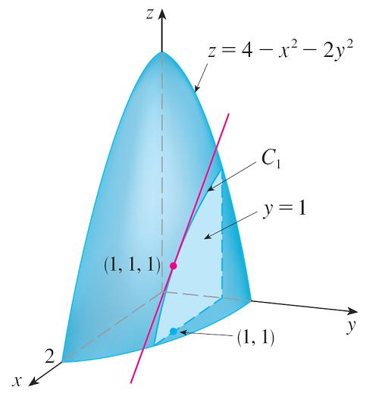
Example 2 – Solution
The graph of f is the paraboloid z = 4 – x² – 2y² and the vertical plane y = 1 intersects it in the parabola z = 2 – x², y = 1. (As in the preceding discussion, we label it C₁ in Figure 2.)
The slope of the tangent line to this parabola at the point (1, 1, 1) is f_{x}(1, 1) = –2.
Figure 2

Slide 45
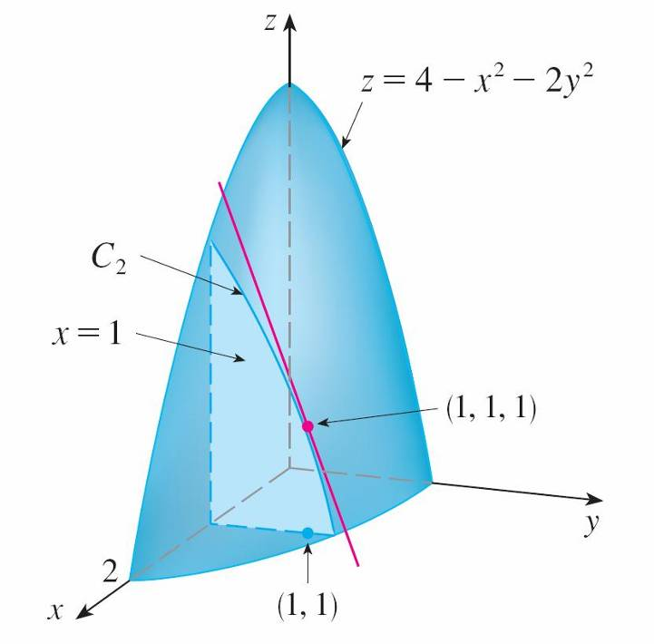
Example 2 – Solution
Similarly, the curve C₂ in which the plane x = 1 intersects the paraboloid is the parabola z = 3 – 2y², x = 1, and the slope of the tangent line at (1, 1, 1) is f_{y}(1, 1) = –4. (See Figure 3.)
Figure 3

Slide 46
Functions of More Than Two Variables
Partial derivatives can also be defined for functions of three or more variables. For example, if f is a function of three variables x, y, and z, then its partial derivative with respect to x is defined as
and it is found by regarding y and z as constants and differentiating f (x, y, z) with respect to x.

Slide 47
Functions of More Than Two Variables
If w = f (x, y, z), then f _{x} = ∂w / ∂x can be interpreted as the rate of change of w with respect to x when y and z are held fixed. But we can’t interpret it geometrically because the graph of f lies in four-dimensional space.
In general, if u is a function of n variables, u = f (x₁, x₂,…, x_{n}), its partial derivative with respect to the i th variable x_{i} is
and we also write

Slide 48
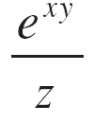
Example 6
Find f_{x}, f_{y}, and f_{z} if f (x, y, z) = e^{xy} ln z.
Solution:
Holding y and z constant and differentiating with respect to x, we have
f_{x} = ye^{xy} ln z
Similarly,
f_{y} = xe^{xy} ln z and f_{z} =

Slide 49
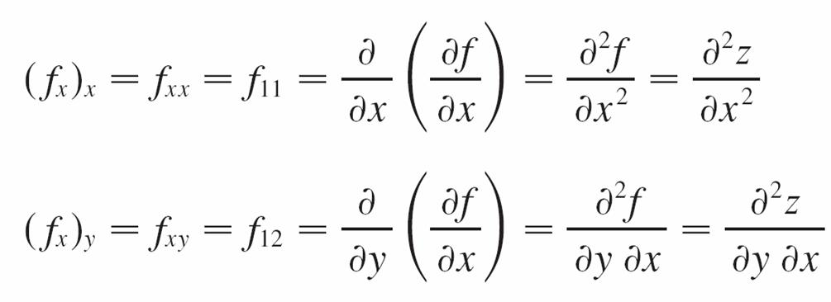
Higher Derivatives
If f is a function of two variables, then its partial derivatives f_{x} and f_{y} are also functions of two variables, so we can consider their partial derivatives (f_{x})_{x}, (f_{x})_{y}, (f_{y})_{x}, and (f_{y})_{y}, which are called the second partial derivatives of f. If z = f (x, y), we use the following notation:

Slide 50
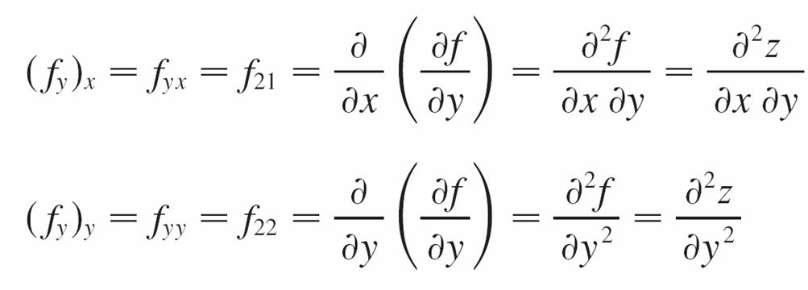
Higher Derivatives
Thus the notation f_{xy} (or ∂²f / ∂y ∂x) means that we first differentiate with respect to x and then with respect to y, whereas in computing f_{yx} the order is reversed.

Slide 51
Example 7
Find the second partial derivatives of
f (x, y) = x³ + x²y³ – 2y²
Solution:
In Example 1 we found that
f_{x}(x, y) = 3x² + 2xy³ f_{y}(x, y) = 3x²y² – 4y
Therefore
f_{xx} = (3x² + 2xy³)
= 6x + 2y³

Slide 52
Example 7 – Solution
f_{xy} = (3x² + 2xy³)
= 6xy²
f_{yx} = (3x²y² – 4y)
= 6xy²
f_{yy} = (3x²y² – 4y)
= 6x²y – 4

Slide 53
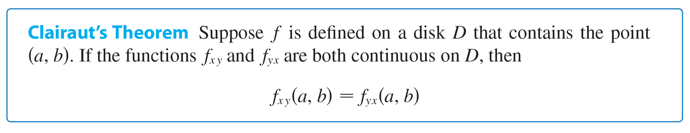
Higher Derivatives
Notice that f_{xy} = f_{yx} in Example 7. This is not just a coincidence. It turns out that the mixed partial derivatives f_{xy} and f_{yx} are equal for most functions that one meets in practice.
The following theorem, which was discovered by the French mathematician Alexis Clairaut (1713–1765), gives conditions under which we can assert that f_{xy} = f_{yx}.
https://en.wikipedia.org/wiki/Disk_(mathematics)

Slide 54
Higher Derivatives
Partial derivatives of order 3 or higher can also be defined. For instance,
and using Clairaut’s Theorem it can be shown that f_{xyy} = f_{yxy} = f_{yyx} if these functions are continuous.

Slide 55
Tangent Planes and Approximations

Slide 56
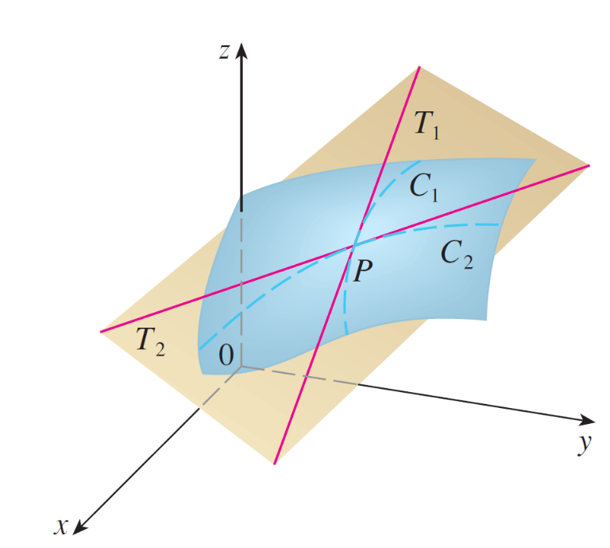
Tangent Planes
The tangent plane to the surface S at the point P is defined to be the plane that contains both tangent lines T₁ and T₂. (See Figure 1.)
The tangent plane contains the tangent lines T₁ and T₂.
Figure 1

Slide 57
Tangent Planes
If C is any other curve that lies on the surface S and passes through P, then its tangent line at P also lies in the tangent plane.
Therefore you can think of the tangent plane to S at P as consisting of all possible tangent lines at P to curves that lie on S and pass through P. The tangent plane at P is the plane that most closely approximates the surface S near the point P. We know that any plane passing through the point P(x₀, y₀, z₀) has an equation of the form
A (x – x₀) + B (y – y₀) + C (z – z₀) = 0

Slide 58

Tangent Planes
By dividing this equation by C and letting a = –A/C and b = –B/C, we can write it in the form
z – z₀ = a(x – x₀) + b(y – y₀)
If Equation 1 represents the tangent plane at P, then its intersection with the plane y = y₀ must be the tangent line T₁. Setting y = y₀ in Equation 1 gives
z – z₀ = a(x – x₀) where y = y₀
and we recognize this as the equation (in point-slope form) of a line with slope a.

Slide 59
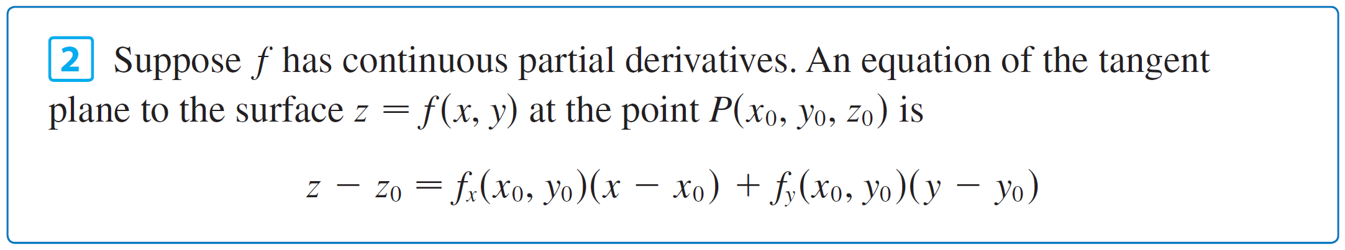
Tangent Planes
But we know that the slope of the tangent T₁ is f_{x} (x₀, y₀).
Therefore a = f_{x} (x₀, y₀).
Similarly, putting x = x₀ in Equation 1, we get z – z₀ = b(y – y₀), which must represent the tangent line T₂, so b = f_{y} (x₀, y₀).

Slide 60
Example 1
Find the tangent plane to the elliptic paraboloid z = 2x² + y² at the point (1, 1, 3).
Solution:
Let f (x, y) = 2x² + y².
Then
f_{x}(x, y) = 4x f_{y}(x, y) = 2y
f_{x}(1, 1) = 4 f_{y}(1, 1) = 2
Then (2) gives the equation of the tangent plane at (1, 1, 3) as
z – 3 = 4(x – 1) + 2(y – 1)
or z = 4x + 2y – 3

Slide 61
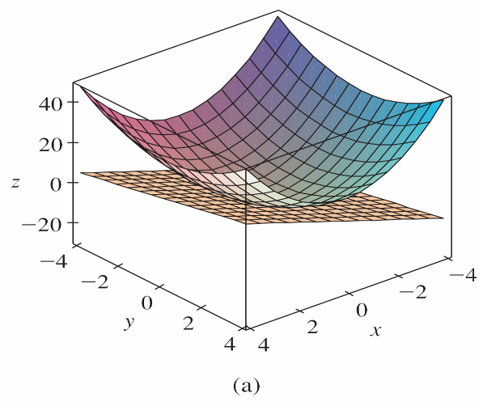
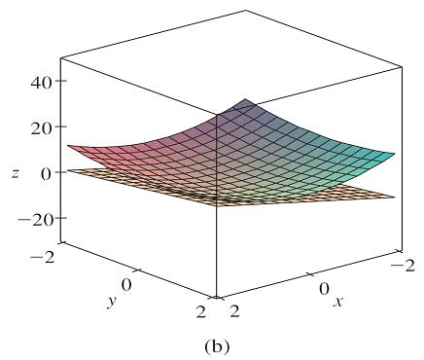
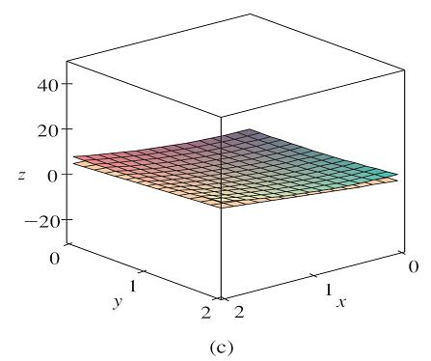
Tangent Planes
Figure 2(a) shows the elliptic paraboloid and its tangent plane at (1, 1, 3) that we found in Example 1. In parts (b) and (c) we zoom in toward the point (1, 1, 3) by restricting the domain of the function f (x, y) = 2x² + y².
The elliptic paraboloid z = 2x² + y² appears to coincide with its tangent plane as we zoom in toward (1, 1, 3).
Figure 2

Slide 62
Linear Approximations
In Example 1 we found that an equation of the tangent plane to the graph of the function f (x, y) = 2x² + y² at the point (1, 1, 3) is z = 4x + 2y – 3. Therefore, the linear function of two variables
L(x, y) = 4x + 2y – 3
is a good approximation to f (x, y) when (x, y) is near (1, 1). The function L is called the linearization of f at (1, 1) and the approximation
f (x, y) ≈ 4x + 2y – 3
is called the linear approximation or tangent plane approximation of f at (1, 1).

Slide 63
Linear Approximations
For instance, at the point (1.1, 0.95) the linear approximation gives
f (1.1, 0.95) ≈ 4(1.1) + 2(0.95) – 3 = 3.3
which is quite close to the true value of
f (1.1, 0.95) = 2(1.1)² + (0.95)² = 3.3225.
But if we take a point farther away from (1, 1), such as (2, 3), we no longer get a good approximation.
In fact, L(2, 3) = 11 whereas f (2, 3) = 17.

Slide 64
Linear Approximations
In general, we know from (2) that an equation of the tangent plane to the graph of a function f of two variables at the point (a, b, f (a, b)) is
z = f (a, b) + f_{x}(a, b)(x – a) + f_{y}(a, b)(y – b)
The linear function whose graph is this tangent plane, namely
L (x, y) = f (a, b) + f_{x}(a, b)(x – a) + f_{y}(a, b)(y – b)
is called the linearization of f at (a, b).

Slide 65

Linear Approximations
The approximation
f (x, y) ≈ f (a, b) + f_{x}(a, b)(x – a) + f_{y}(a, b)(y – b)
is called the linear approximation or the tangent plane approximation of f at (a, b).

Slide 66
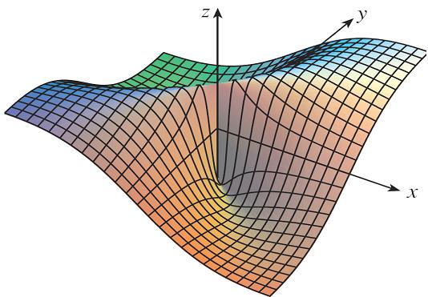
Linear Approximations
We have defined tangent planes for surfaces z = f (x, y), where f has continuous first partial derivatives. What happens if f_{x} and f_{y} are not continuous? Figure 4 pictures such a function; its equation is
You can verify that its partial derivatives exist at the origin and, in fact, f_{x}(0, 0) = 0 and f_{y}(0, 0) = 0, but f_{x} and f_{y} are not continuous.
Figure 4

Slide 67
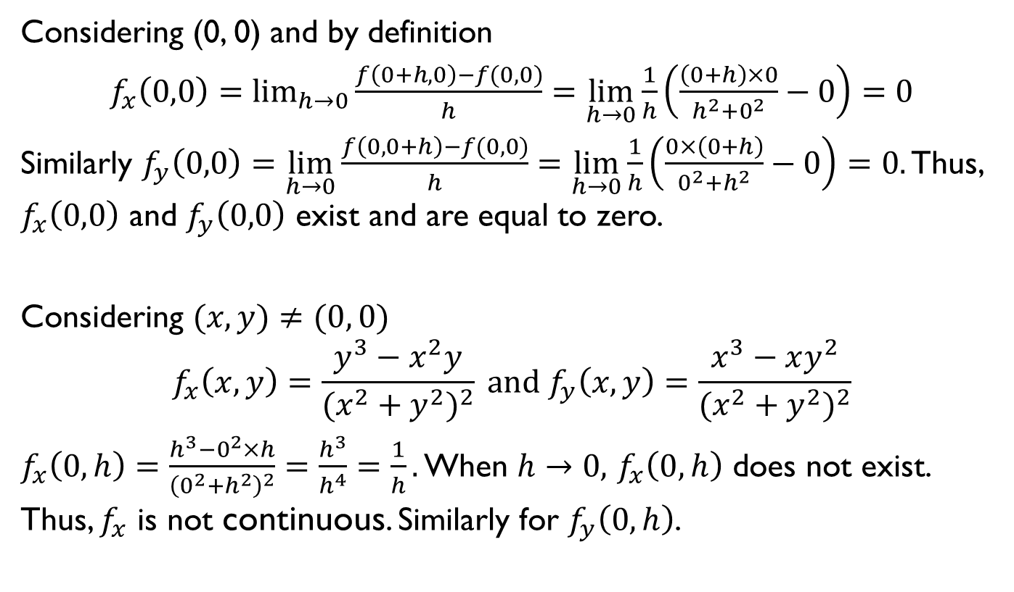
Linear Approximations
Considering (0, 0) and by definition
$f_{x}\left(0,0\right)=\lim_{h→0}{\frac{f\left(0+h,0\right)−f(0,0)}{h}=}$ $\lim_{h→0}\frac{1}{h}\left(\frac{\left(0+h\right)×0}{h^{2}+0^{2}}−0\right)=0$
Similarly $f_{y}\left(0,0\right)=\lim_{h→0}{\frac{f\left(0,0+h\right)−f(0,0)}{h}=}$ $\lim_{h→0}\frac{1}{h}\left(\frac{0×\left(0+h\right)}{0^{2}+h^{2}}−0\right)=0.$ Thus, $f_{x}\left(0,0\right)$ and $f_{y}\left(0,0\right)$ exist and are equal to zero.
Considering $(x,y)≠(0, 0)$
$$f_{x}\left(x,y\right)=\frac{y^{3}−x^{2}y}{{(x^{2}+y^{2})}^{2}} and f_{y}\left(x,y\right)=\frac{x^{3}−xy^{2}}{{(x^{2}+y^{2})}^{2}}$$
$f_{x}\left(0,h\right)=\frac{h^{3}−0^{2}×h}{{\left(0^{2}+h^{2}\right)}^{2}}=\frac{h^{3}}{h^{4}}=\frac{1}{h}.$ When $h→0,$ $f_{x}\left(0,h\right)$ does not exist. Thus, $f_{x}$ is not continuous. Similarly for $f_{y}\left(0,h\right)$.

Slide 68

Linear Approximations
The linear approximation would be f (x, y) ≈ 0, but f (x, y) = at all points on the line y = x.
So a function of two variables can behave badly even though both of its partial derivatives exist.
To rule out such behavior, we formulate the idea of a differentiable function of two variables.
Recall that for a function of one variable, y = f (x), if x changes from a to a + Δx, we defined the increment of y as
Δy = f (a + Δx) – f (a)

Slide 69


Linear Approximations
If f is differentiable at a, then
Δy = f ′(a) Δx + ε Δx where ε → 0 as Δx → 0
Now consider a function of two variables, z = f (x, y), and suppose x changes from a to a + Δx and y changes from b to b + Δy. Then the corresponding increment of z is
Δz = f (a + Δx, b + Δy) – f (a, b)
Thus the increment Δz represents the change in the value of f when (x, y) changes from (a, b) to (a + Δx, b + Δy).

Slide 70
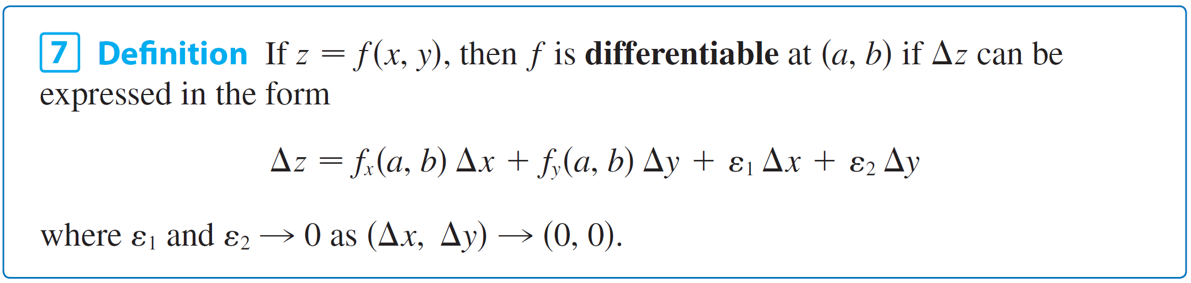
Linear Approximations
By analogy with (5) we define the differentiability of a function of two variables as follows.
Definition 7 says that a differentiable function is one for which the linear approximation (4) is a good approximation when (x, y) is near (a, b). In other words, the tangent plane approximates the graph of f well near the point of tangency

Slide 71
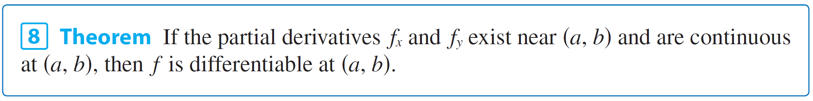
Linear Approximations
It’s sometimes hard to use Definition 7 directly to check the differentiability of a function, but the next theorem provides a convenient sufficient condition for differentiability.

Slide 72
Example 2
Show that f (x, y) = xe^{xy} is differentiable at (1, 0) and find its linearization there. Then use it to approximate f(1.1,– 0.1).
Solution:
The partial derivatives are
f_{x}(x, y) = e^{xy} + xye^{xy} f_{y}(x, y) = x²e^{xy}
f_{x}(1, 0) = 1 f_{y}(1, 0) = 1
Both f_{x} and f_{y} are continuous functions, so f is differentiable by Theorem 8. The linearization is
L(x, y) = f (1, 0) + f_{x}(1, 0)(x – 1) + f_{y}(1, 0)(y – 0)
= 1 + 1(x – 1) + 1  y = x + y

Slide 73
Example 2 – Solution
The corresponding linear approximation is
xe^{xy} ≈ x + y
so f(1.1,– 0.1) ≈ 1.1 – 0.1 = 1
Compare this with the actual value of
f(1.1,– 0.1) = 1.1e ^{–0.11}
≈ 0.98542.

Slide 74

Differentials
For a differentiable function of one variable, y = f (x), we define the differential dx to be an independent variable; that is, dx can be given the value of any real number.
The differential of y is then defined as
dy = f ′(x) dx

Slide 75
Differentials
Figure 6 shows the relationship between the increment Δy and the differential dy: Δy represents the change in height of the curve y = f (x) and dy represents the change in height of the tangent line when x changes by an amount dx = Δx.
Figure 6

Slide 76
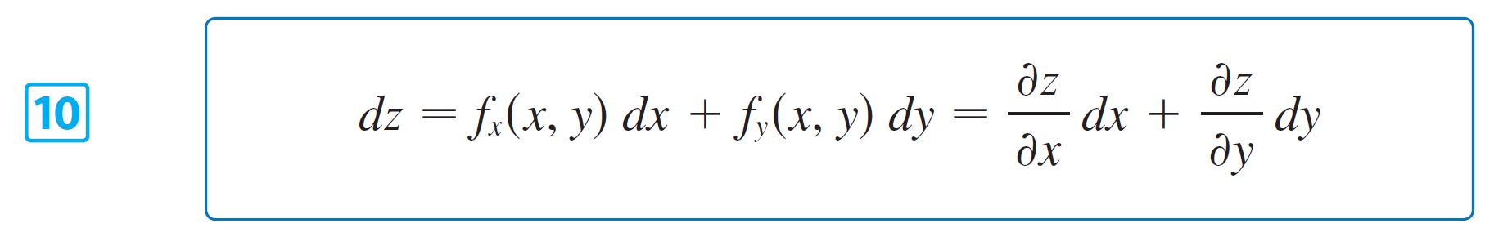
Differentials
For a differentiable function of two variables, z = f (x, y), we define the differentials dx and dy to be independent variables; that is, they can be given any values. Then the differential dz, also called the total differential, is defined by
Sometimes the notation df is used in place of dz.

Slide 77
Differentials
If we take dx = Δx = x – a and dy = Δy = y – b in Equation 10, then the differential of z is
dz = f_{x}(a, b)(x – a) + f_{y}(a, b)(y – b)
So, in the notation of differentials, the linear approximation (4) can be written as
f (x, y) ≈ f (a, b) + dz

Slide 78
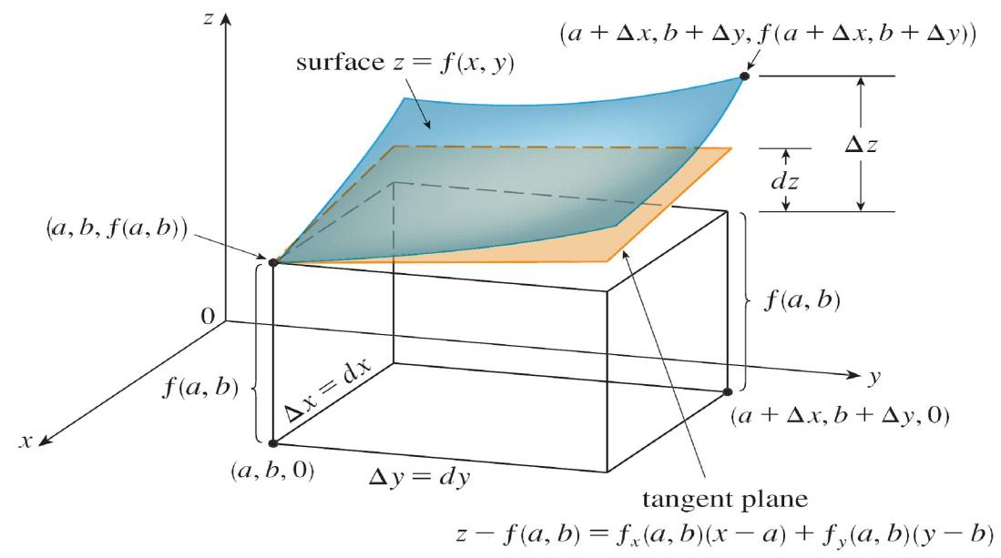
Differentials
Figure 7 is the three-dimensional counterpart of Figure 6 and shows the geometric interpretation of the differential dz and the increment Δz: dz represents the change in height of the tangent plane, whereas Δz represents the change in height of the surface z = f (x, y) when (x, y) changes from (a, b) to (a + Δx, b + Δy).
Figure 6
Figure 7

Slide 79

Example 4
(a) If z = f (x, y) = x² + 3xy – y², find the differential dz.
(b) If x changes from 2 to 2.05 and y changes from 3 to 2.96, compare the values of Δz and dz.
Solution:
(a) Definition 10 gives

Slide 80
Example 4 – Solution
(b) Putting x = 2, dx = Δx = 0.05, y = 3, and dy = Δy = –0.04, we get
dz = [2(2) + 3(3)]0.05 + [3(2) – 2(3)](–0.04)=0.65
The increment of z is
Δz = f (2.05, 2.96) – f (2, 3)
= [(2.05)² + 3(2.05)(2.96) – (2.96)²] – [2² + 3(2)(3) – 3²]
= 0.6449
Notice that Δz ≈ dz but dz is easier to compute.

Slide 81
Functions of Three or More Variables
Linear approximations, differentiability, and differentials can be defined in a similar manner for functions of more than two variables. A differentiable function is defined by an expression similar to the one in Definition 7. For such functions the linear approximation is
f (x, y, z) ≈ f (a, b, c) + f_{x}(a, b, c)(x – a) + f_{y}(a, b, c)(y – b) + f_{z}(a, b, c)(z – c)
and the linearization L(x, y, z) is the right side of this expression.

Slide 82
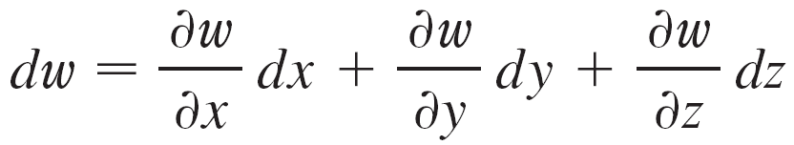
Functions of Three or More Variables
If w = f (x, y, z), then the increment of w is Δw = f (x + Δx, y + Δy, z + Δz) – f (x, y, z)
The differential dw is defined in terms of the differentials dx, dy, and dz of the independent variables by

Slide 83

Example 6
The dimensions of a rectangular box are measured to be 75 cm, 60 cm, and 40 cm, and each measurement is correct to within 0.2 cm. Use differentials to estimate the largest possible error when the volume of the box is calculated from these measurements.
Solution:
If the dimensions of the box are x, y, and z, its volume is V = xyz and so

Slide 84
Example 6 – Solution
We are given that | Δx | ≤ 0.2, | Δy | ≤ 0.2, and | Δz | ≤ 0.2.
To estimate the largest error in the volume, we therefore use dx = 0.2, dy = 0.2, and dz = 0.2 together with x = 75, y = 60, and z = 40:
ΔV ≈ dV = (60)(40)(0.2) + (75)(40)(0.2) + (75)(60)(0.2)
= 1980

Slide 85
Example 6 – Solution
Thus an error of only 0.2 cm in measuring each dimension could lead to an error of approximately 1980 cm³ in the calculated volume! This may seem like a large error, but it’s only about 1% of the volume of the box.

